Slide 1
Innovation Day
Gorka Madariaga
Technical Evangelist
@Gk_8

Slide 2



Microsoft Platform
Build the intelligent cloud
Reinvent productivity & business process
Create more personal computing

Slide 3
Microsoft Platform
Build the intelligent cloud
Build the intelligent cloud
Reinvent productivity & business process
Create more personal computing

Slide 4

32
Hyper-scale footprint
Azure regions around the world
Azure regions
More than AWS and Google Cloud combined

Slide 5
>120k
>1.4Million
2Trillion
NEW AZURE CUSTOMER SUBSCRIPTIONS/MONTH
SQL DATABASES IN AZURE
MESSAGES PER WEEK PROCESSED BY AZURE IOT
5Million
>4Million
>40%
ORGANIZATIONS USING AZURE ACTIVE DIRECTORY
DEVELOPER REGISTERED WITH VISUAL STUDIO TEAM SERVICES
REVENUE FROM START-UPS AND ISVS

Slide 6
Over 85% of Fortune 500 use Microsoft Cloud

Slide 7
Microsoft Platform
Build the intelligent cloud
Reinvent productivity & business process
Create more personal computing
Reinvent productivity & business process

Slide 8

1.2Billion
>50k
4Trillion
USERS OF MICROSOFT OFFICE
NEW OFFICE 365 SMALL BUSINESS PER MONTH
EMAILS SENT WITH
OFFICE 365

Slide 9
Microsoft Graph API calls
420% monthly growth

Slide 10
Microsoft Platform
Build the intelligent cloud
Reinvent productivity & business process
Create more personal computing
Create more personal computing

Slide 11

>300Million
>75Billion
>6Billion
ACTIVE WINDOWS 10 DEVICES
HOURS SPENT ON WINDOWS 10
QUESTIONS ANSWERED BY CORTANA
>500
>9Billion
>5Billion
NEW DEVICES DESIGNED FOR WINDOWS 10
HOURS OF GAMEPLAY LOGGED SINCE LAUNCH
STORE VISITS

Slide 12
Build the intelligent cloud
Reinvent productivity & business process
Create more personal computing
Windows, Office, and Azure together offer a full end-to-end device + intelligent cloud platform

Slide 13


Home for
Developers
Cross-Platform
Conversations
as a Platform
Internet of Things
Microservices
Data and Analytics
An end-to-end story for developers

Slide 14
Home for
Developers
Cross-Platform
Conversations
as a Platform
Home for
Developers
Internet of Things
Microservices
Data and Analytics
Windows is home for developers

Slide 15
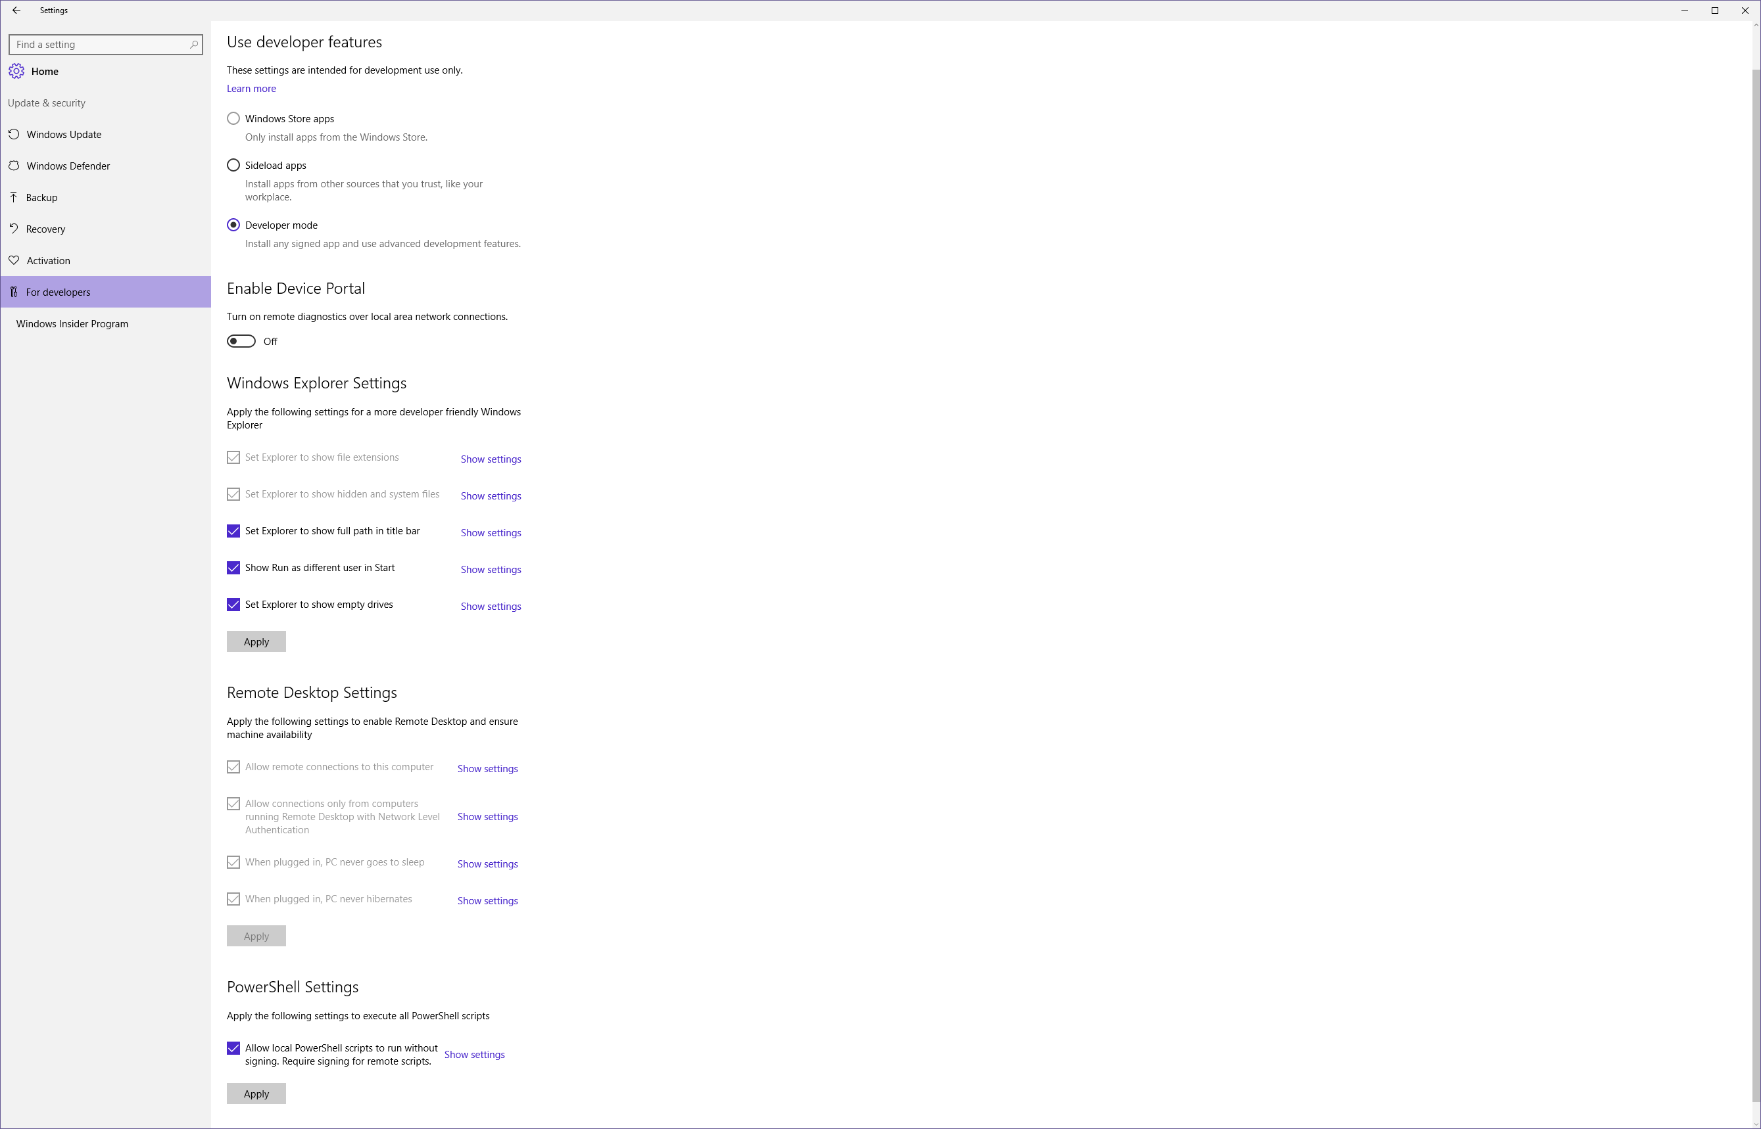
Windows 10 includes features specifically for developers
TODO: Update screenshot

Slide 16
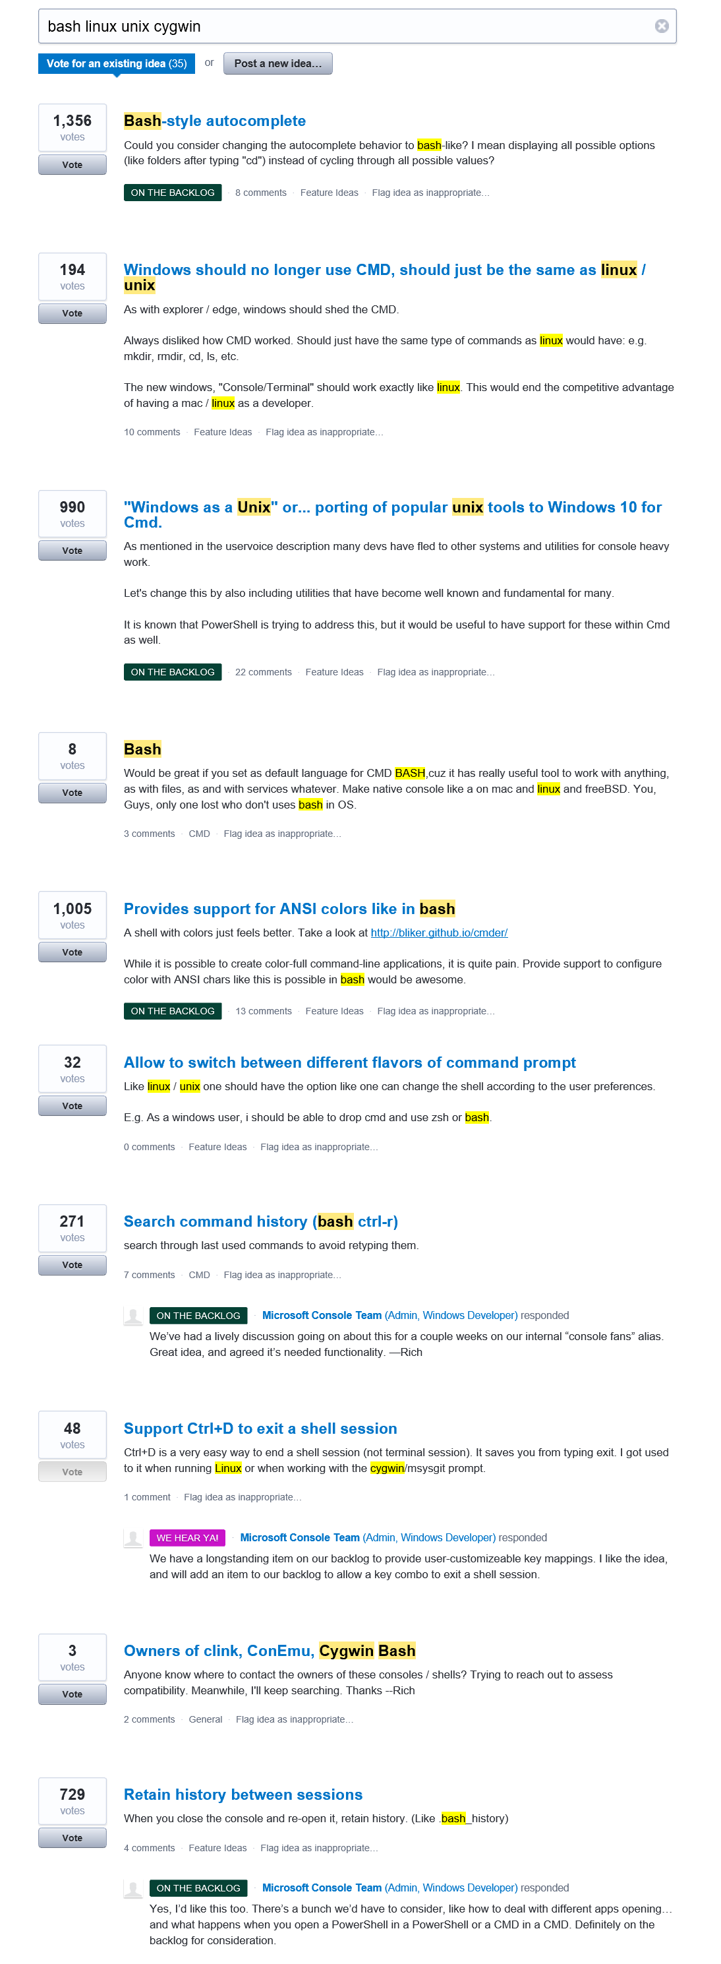
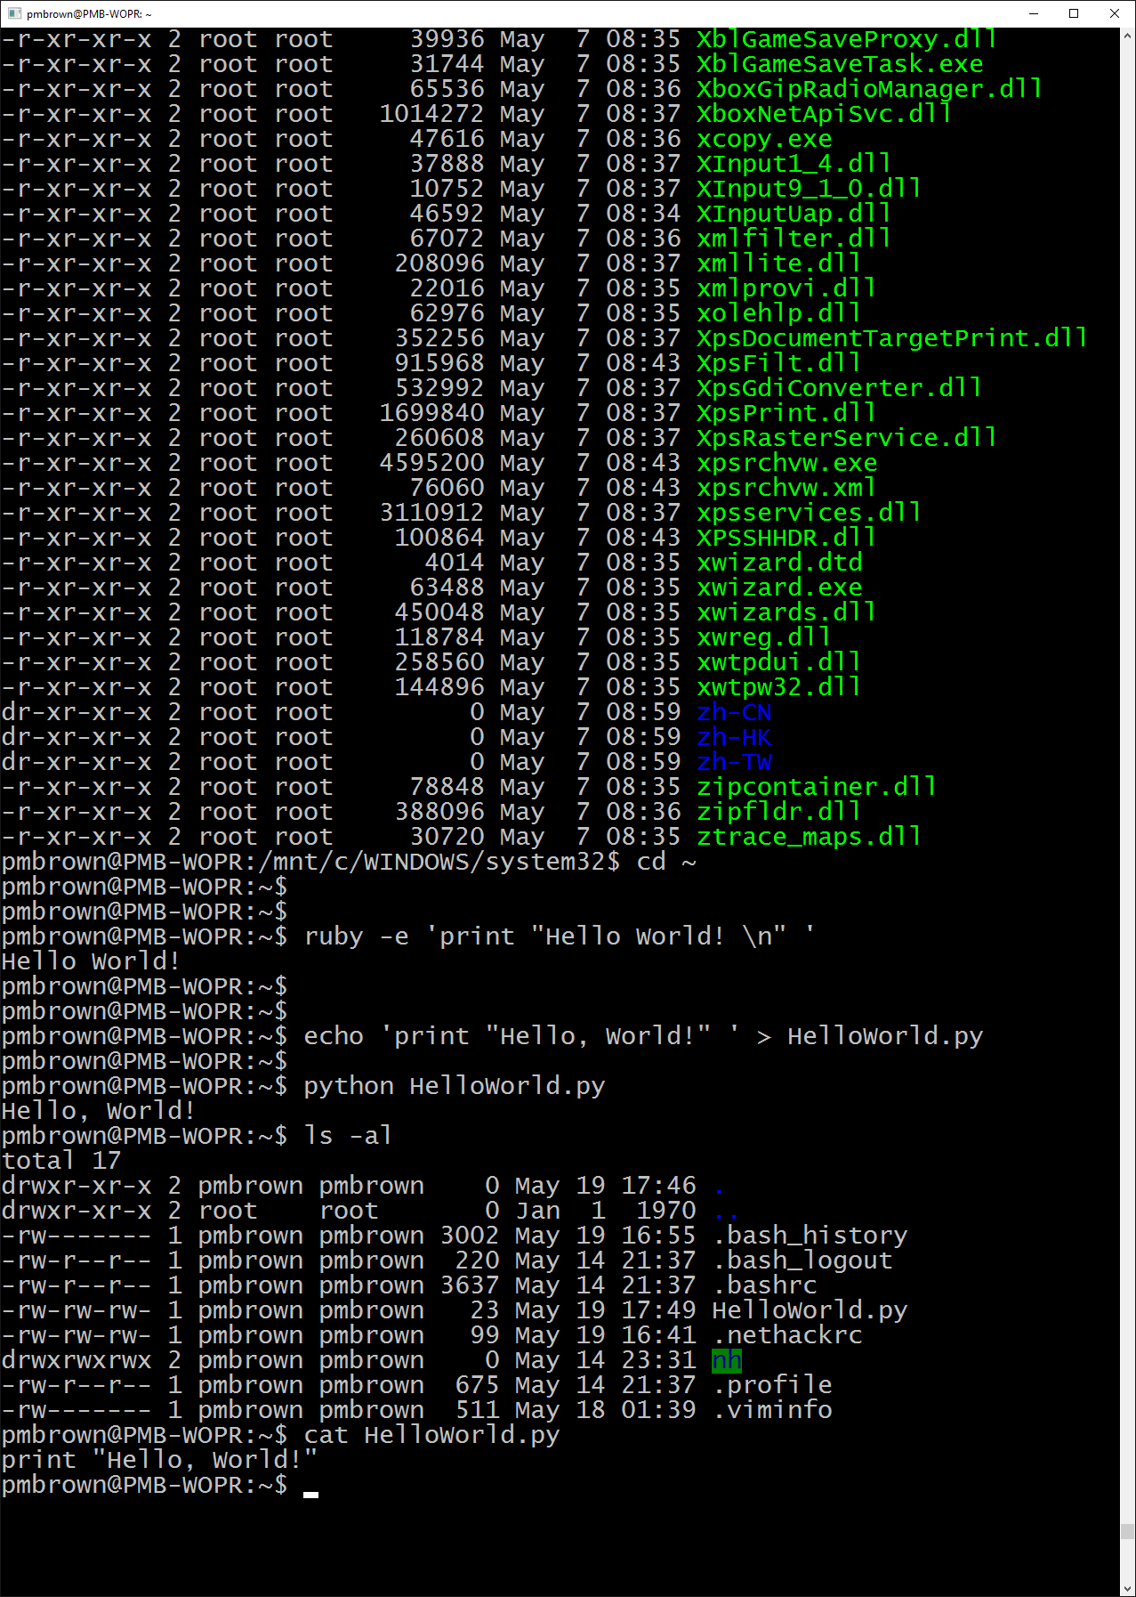
You asked us to bring better support for Unix/Linux tools and languages to Windows
emacs
gcc
bash
grep
ruby
python
make
awk
ssh
sed
java
vi
git
node
mc
apt

Slide 17
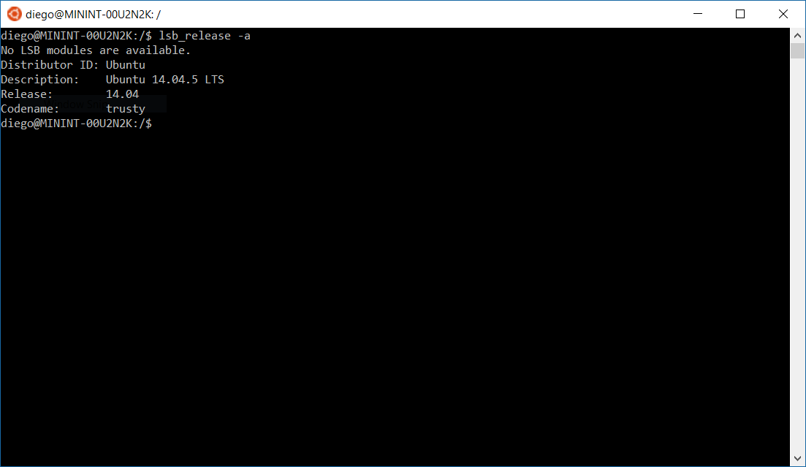
Bash on Ubuntu
available for Windows

Slide 18
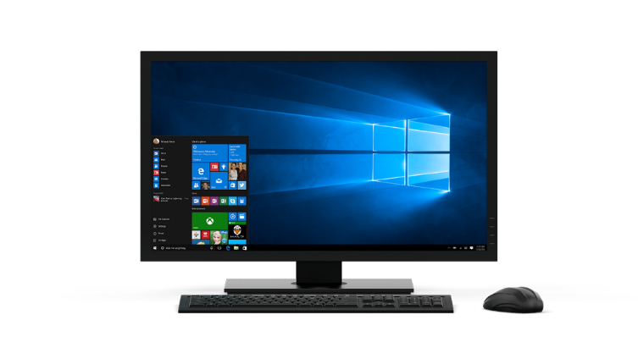
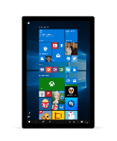
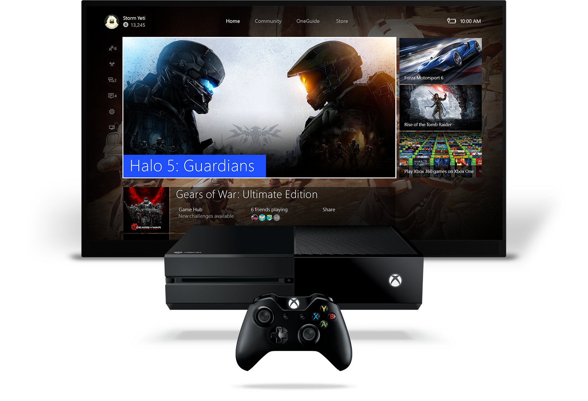
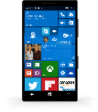
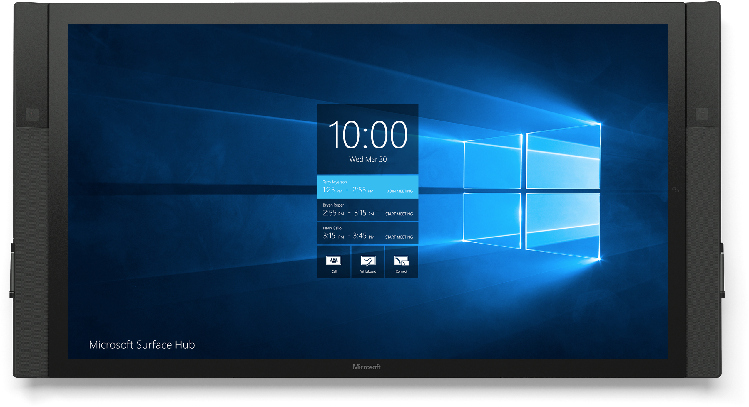
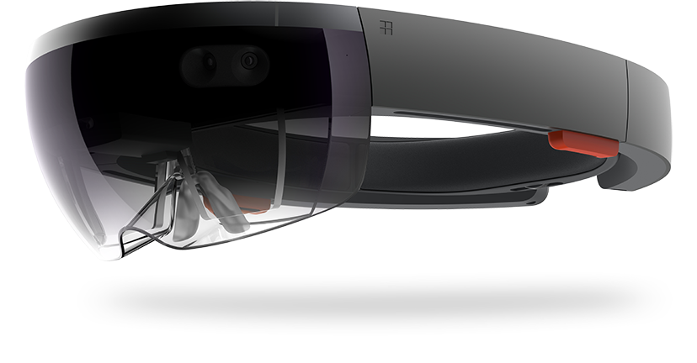
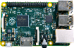
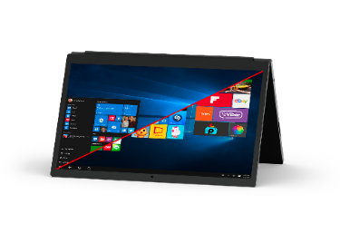
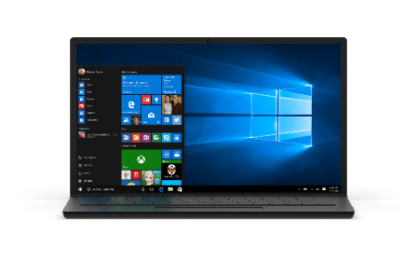
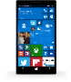
More personal computing
Power to transcend a single device
Natural User Interaction
Backed by Intelligence

Slide 19
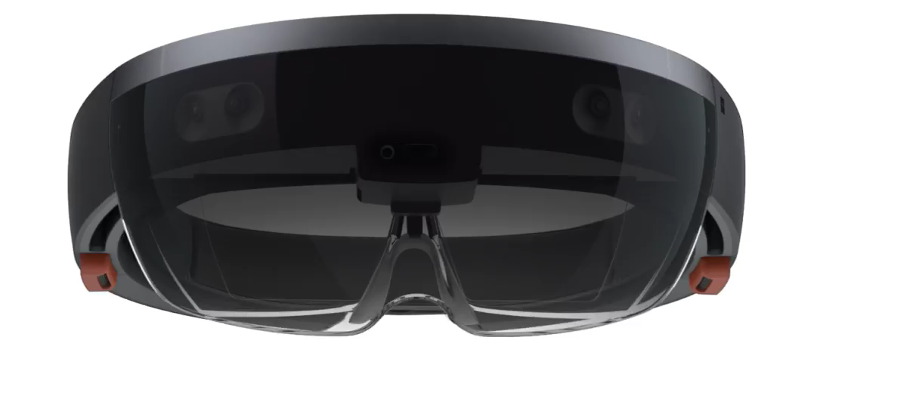
Life beyond the ordinary range of perception

Slide 20
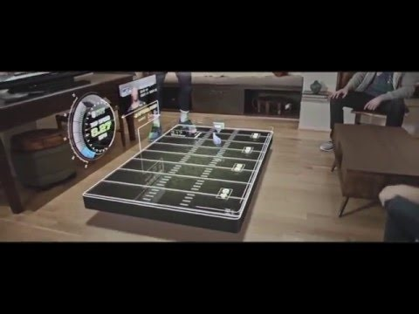

Slide 21
Home for
Developers
Home for
Developers
Cross-Platform
Cross-Platform
Conversations
as a Platform
Internet of Things
Microservices
Data and Analytics
Windows is home for cross-platform
developers

Slide 22

Windows Phone Silverlight
WPF and Windows Forms
iOS
Win32
.NET
win32
Easy to get started while keeping your current investments

Slide 23
Hosted Web Apps
Hosted Web Apps are a First Class UWP across the entire Windows device family.
Can be built from the W3C standard manifest and submitted directly to store
Full access to Universal APIs like
Tiles, Notifications, Camera, Contact List, Calendar
{ }
HTML
CSS
JS
W3C
manifest
app package
Platform Integrations

Slide 24
Desktop Bridge
Keep the user’s apps always up to date through the Store
Enhance and extend the app to light up new Windows 10 features
Simple to convert existing installers
Desktop App Convertor
Support for WIX and InstallShield
.msi
.appx

Slide 25
We open sourced the Xamarin runtime and contributed it to the .NET foundation

Slide 26
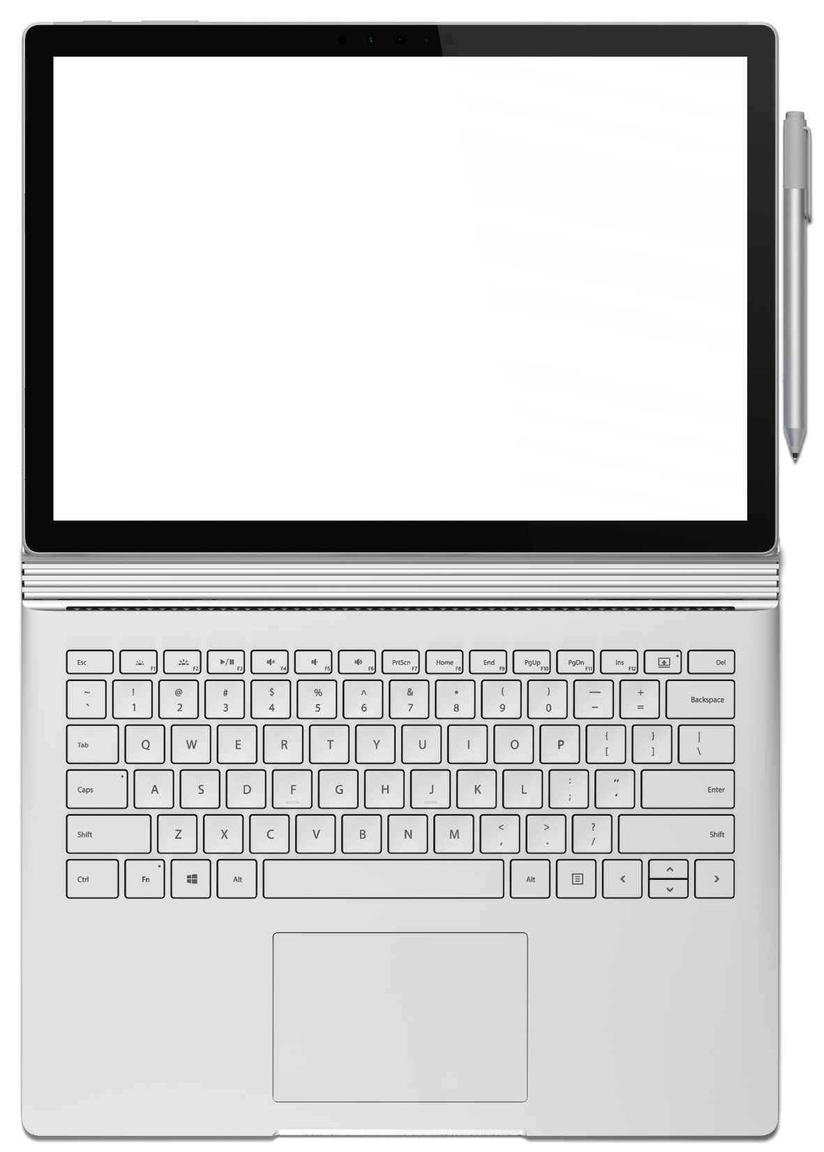
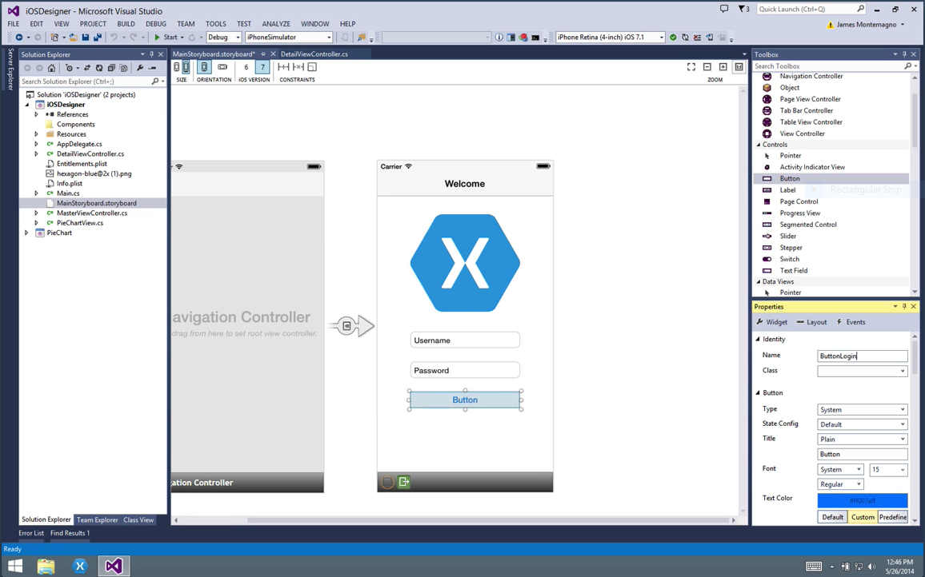
Xamarin for Visual Studio
Visual Studio Enterprise
Visual Studio Professional
Visual Studio Community Edition
Now included for free!

Slide 27
Home for
Developers
Cross-Platform
Conversations
as a Platform
Internet of Things
Microservices
Data and Analytics
Microsoft is home for conversations as a platform

Slide 28
IT’S YOUR JOB TO FIGURE OUT THE COMPUTER
LET’S MAKE
THE COMPUTER FIGURE OUT YOU
THE COMPUTER

Slide 29
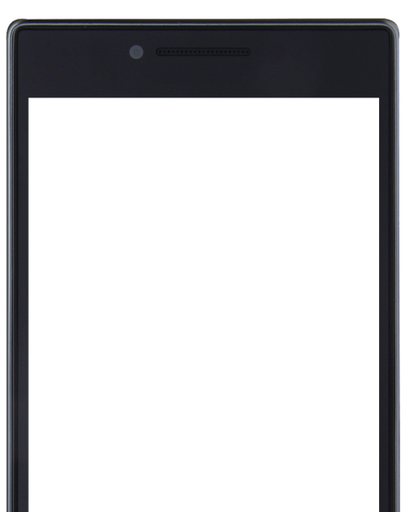
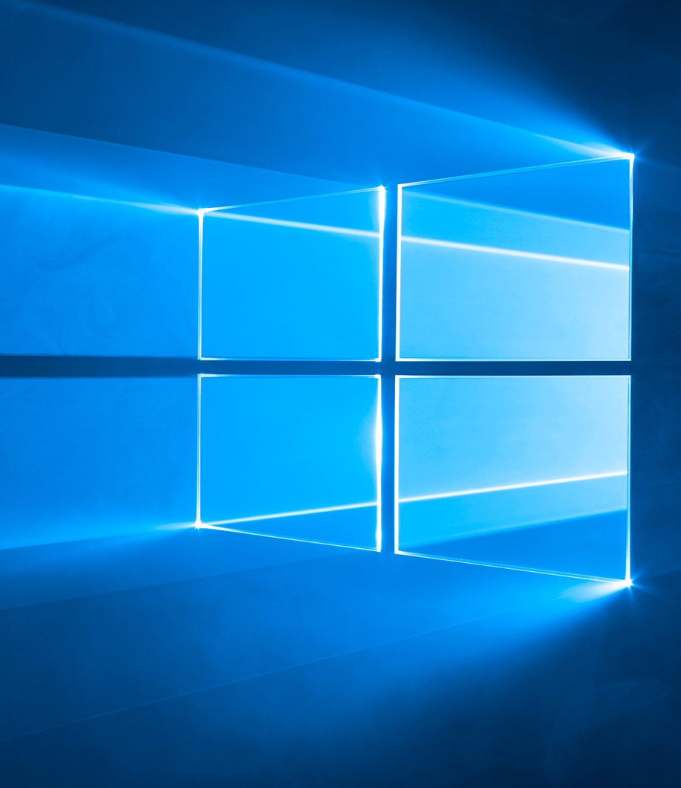

Slide 30





The Microsoft Bot Framework Building bots is complex
BOT CONNECTOR
COGNITIVE SERVICES
BOTBUILDER

Slide 31
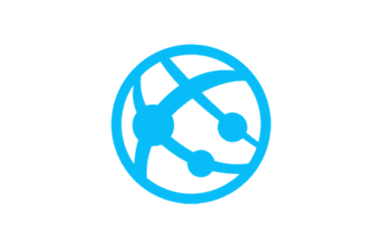




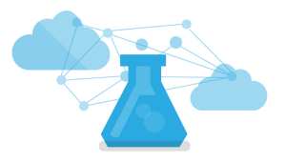

The Bot Brain
Storage
Compute
Cognitive Services

Slide 32
Home for
Developers
Home for
Developers
Cross-Platform
Conversations
as a Platform
Cross-Platform
Conversations
as a Platform
Internet of Things
Internet of Things
Microservices
Data and Analytics
Azure is home for IoT data and services

Slide 33






























Partners are building solutions with Azure IoT

Slide 34
Things
Azure IoT Suite
Device Connectivity and Security
Data Ingestion and Command & Control
Stream Processing & Predictive Analytics
Workflow Automation
Dashboards and Visualization
Preconfigured Solutions

Slide 35
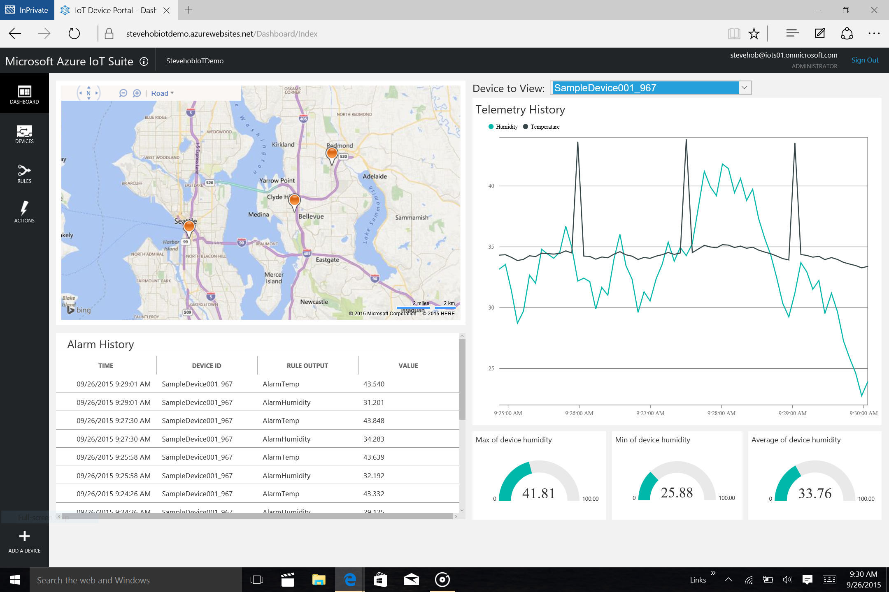

Slide 36
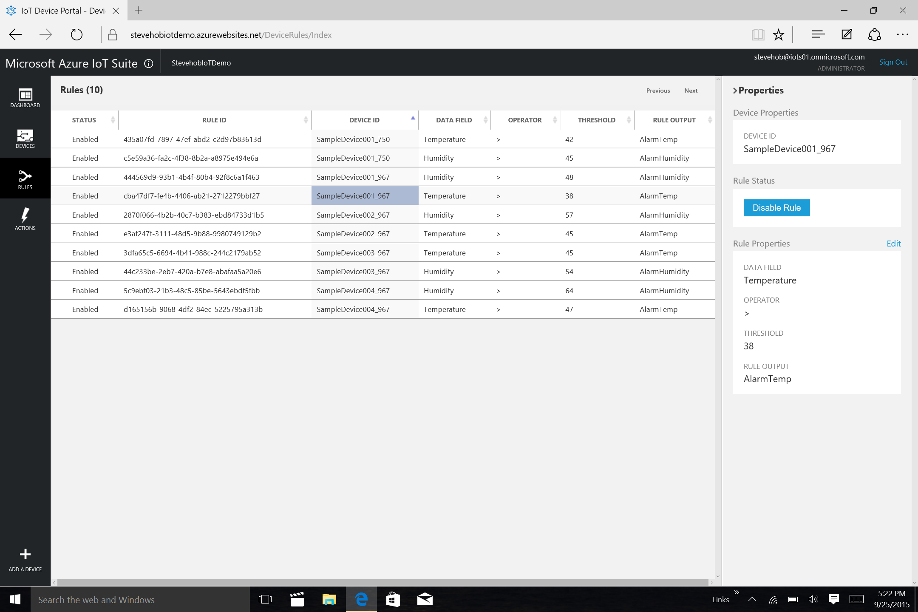

Slide 37

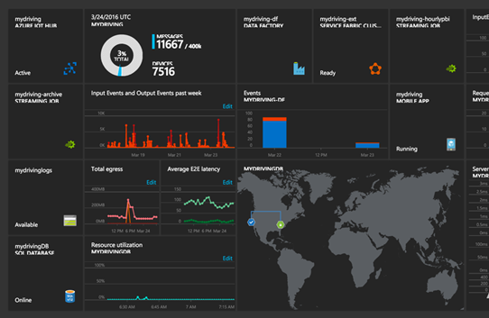
Now available
Azure IoT Updates
Azure IoT Starter Kits available
Azure IoT Hub Device Management preview
Azure IoT Gateway SDK preview

Slide 38
Home for
Developers
Home for
Developers
Cross-Platform
Conversations
as a Platform
Cross-Platform
Conversations
as a Platform
Internet of Things
Internet of Things
Microservices
Data and Analytics
Microservices
Microservices enable you to create applications from building blocks

Slide 39
Service Fabric
prescriptive microservices framework
Container Service
orchestration and composition
VM Scale Sets
flexible infrastructure
Microservices with Azure

Slide 40
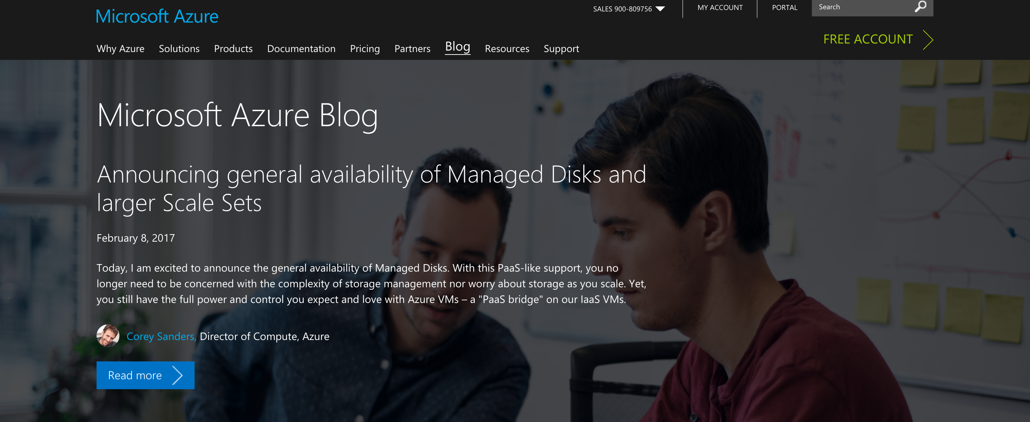

Slide 41

Azure Container Service
Standard Docker tooling and API support
Streamlined provisioning of Apache Mesos and Docker Swarm
Linux and Windows Server containers
Azure and Azure Stack

Slide 42
Azure Service Fabric
Prescriptive microservice platform
Stateful and stateless microservices in Docker containers
.NET and Java API’s on Windows Server and Linux
Deploy on Azure, Azure Stack, VMware, OpenStack, AWS

Slide 43
Now available
Azure Functions Preview
Serverless compute
Trigger on events in Azure + external services
Pay only per execution
C#, Node.js code
Open source runtime runs anywhere

Slide 44
Home for
Developers
Home for
Developers
Cross-Platform
Conversations
as a Platform
Cross-Platform
Conversations
as a Platform
Internet of Things
Data and Analytics
Internet of Things
Microservices
Data and Analytics
Microservices
Power BI brings your data to life

Slide 45
Intelligent action
What happened?
Why did it happen?
What will happen?
What should I do?

Slide 46
Power BI
Machine Learning
SQL Data Warehouse
HDInsight
Data Lake Analytics
Data Lake Store
Stream Analytics
Data Factory
Data Catalog
Event Hubs
Information management
Big Data stores
Machine Learning
Analytics

Slide 47

Cortana Intelligence Suite

Slide 48






Cortana Intelligence Suite Transform data into intelligent action
Information Management
Big Data Stores
Machine Learning and Analytics
Dashboards and Visualizations
Business apps
Power BI
Azure
Data Factory
Azure
Machine Learning
Personal Digital Assistant
Azure
Data Lake
Cortana
People
Custom apps
Azure
Data Catalog
Azure
HDInsight (Hadoop)
Perceptual Intelligence
Azure
SQL Data Warehouse
Face, vision
Speech, text
Azure
Event Hub
Azure
Stream Analytics
Business Scenarios
Sensors and devices
Recommendations,
customer churn,
forecasting, etc.
Automated Systems
DATA
INTELLIGENCE
ACTION

Slide 49
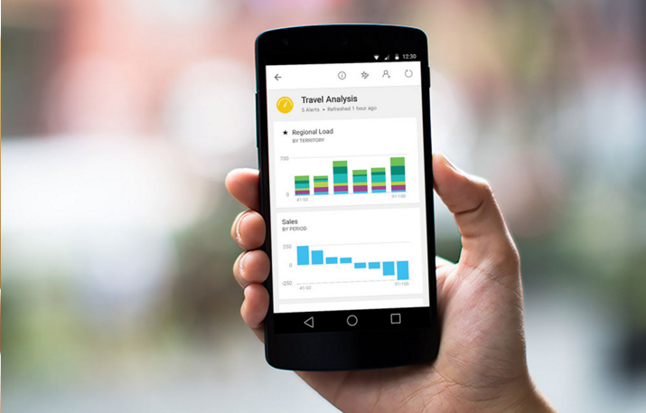
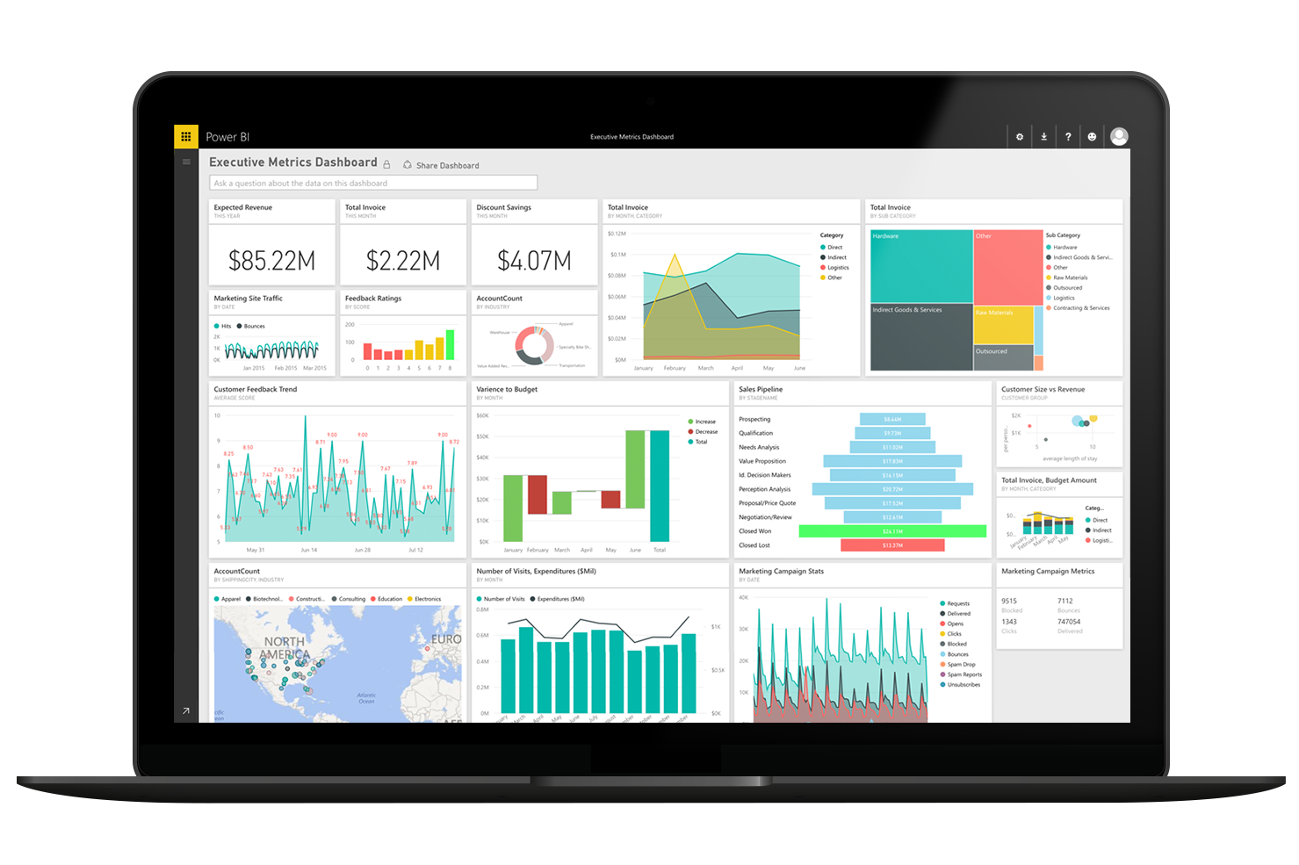
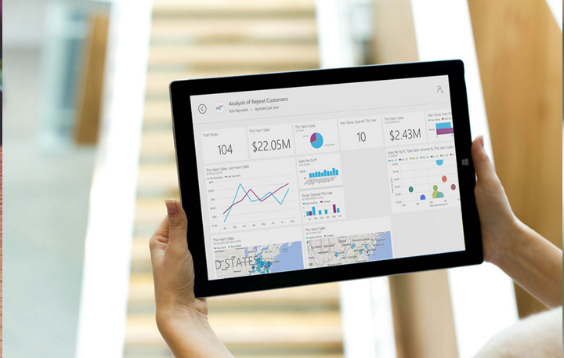
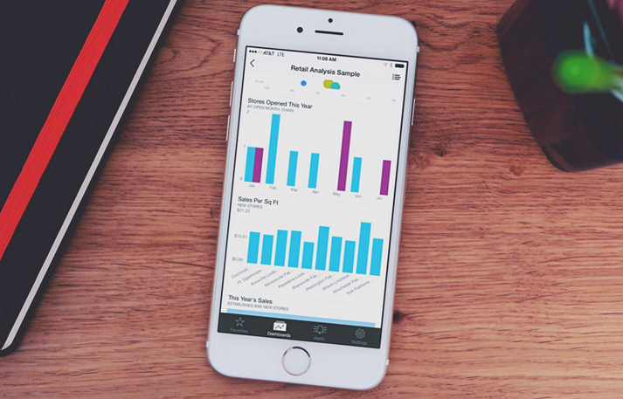
Microsoft Power BI

Slide 50
Now available Power BI Embedded
In-app data visualization and reporting
Support custom BI visuals
Seamless customer experience

Slide 51
Build the intelligent cloud
Reinvent productivity & business process
Create more personal computing
Windows, Office, and Azure together offer a platform you can build on to
do great things

Slide 52


Slide 53
The Artificial Intelligence Revolution We are on the cusp of another transformative era
Nomads
Cities
Internet
Farmers
Machines
Cloud Computing

Slide 54
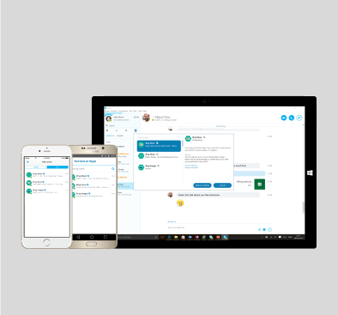
Thank You!

